Slide 1
CHAPTER 4 DATA ANALYSIS
8 Hrs.
9 Marks

Slide 2
OVERVIEW
Data analytics: Descriptive, diagnostic, predictive and prescriptive analytics
Exploratory data analysis using descriptive statistics
Data visualization
Data visualization techniques
Principles of effective data visualization
Feature engineering and other aspects of data manipulation

Slide 3

DATA ANALYSIS
Systematic approach that transforms raw data into valuable insights
Encompasses a suite of technologies and tools that facilitate data collection, cleaning, transformation, and modelling, ultimately yielding actionable information
Serves as a robust support system for decision-making
Plays a pivotal role in business growth and performance optimization
Provides a concise overview of quantitative data by presenting statistical summaries
Data analysts, data scientists, and data engineers together create data pipelines which helps to set up the model and do further analysis

Slide 4
PROCESS OF DATA ANALYTICS – [1]
Data Collection
Raw data needs to be collected for analysis purposes
If the data are from different source systems then using data integration routines the data analysts have to combine the different data
If the data are the subset of the data set, the data analyst would perform some steps to extract the useful subset and transfer it to the other compartment in the system
Data Cleansing
As the collected data consists of a lot of quality problems such as errors, duplicate entries and white spaces which need to be corrected before moving to the next step
Errors can be corrected by running data profiling and data cleansing tasks

Slide 5
PROCESS OF DATA ANALYTICS – [2]
Data Analysis and Data Interpretation
Analytical models are created using software and other tools which interpret the data and understand it
Tools include Python, Excel, R, Scala and SQL
The model is tested again and again until the model works as it needs to be then in production mode the data set is run against the model
Data Visualisation
Process of creating visual representation of data using the plots, charts and graphs which helps to analyse the patterns, trends and get the valuable insights of the data
Data analysts find the useful data from the raw data by comparing the datasets and analysing

Slide 6
TYPES OF DATA ANALYSIS – [1]
Descriptive Data Analytics
Summarizes the data set and it is used to compare the past results, differentiate between the weakness and strength, and identify the anomalies
Used by the companies to identify the problems in the data set as it helps in identifying the patterns
Diagnostic Data Analytics
Uses past data sets to analyse the cause of an anomaly
Some of the techniques used in diagnostic analysis are correlation analysis, regression analysis and analysis of variance
Results from diagnostic analysis help the companies to give accurate solutions to the problems

Slide 7
TYPES OF DATA ANALYSIS – [2]
Predictive Data Analytics
Performed in the current data to predict future outcomes
To build the predictive models it uses machine learning algorithms, statistical model techniques to identify the trends and patterns
Also used in sales forecasting, to estimate the risk and to predict customer behavior
Prescriptive Data Analytics
An analysis of selecting best solutions to problems
Used in loan approval, pricing models, machine repair scheduling, analyzing the decisions and so on.
Companies use prescriptive data analysis to automate decision making

Slide 8
DESCRIPTIVE STATISTICS – [1]
Branch of statistics focused on summarizing, organizing, and presenting data in a clear and understandable way
Primary aim is to define and analyze the fundamental characteristics of a dataset without making sweeping generalizations or assumptions about the entire data set
Provides a straightforward and concise overview of the data, enabling researchers or analysts to gain insights and understand patterns, trends, and distributions within the dataset
Typically involve measures of central tendency (mean, median, mode), dispersion (range, variance, standard deviation), and distribution shape (skewness and kurtosis)
Graphical representations like histograms, bar charts, pie charts, scatter plots and box plots are commonly used to visualize and interpret the data

Slide 9
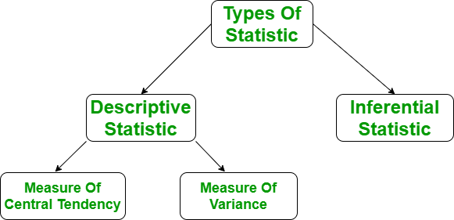
TYPES OF DESCRIPTIVE STATISTICS
Measures of Central Tendency
Measure of Variability
Measures of Frequency Distribution

Slide 10
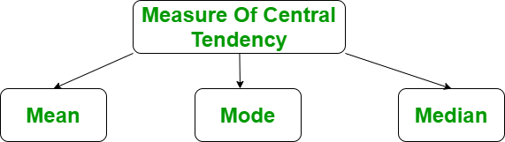
MEASURES OF CENTRAL TENDENCY
Central tendency is defined as a statistical measure that may be used to describe a complete distribution or dataset with a single value, known as a measure of central tendency
Any of the central tendency measures accurately describes the whole data distribution
The central tendency measures are:
Mean
Median
Mode

Slide 11
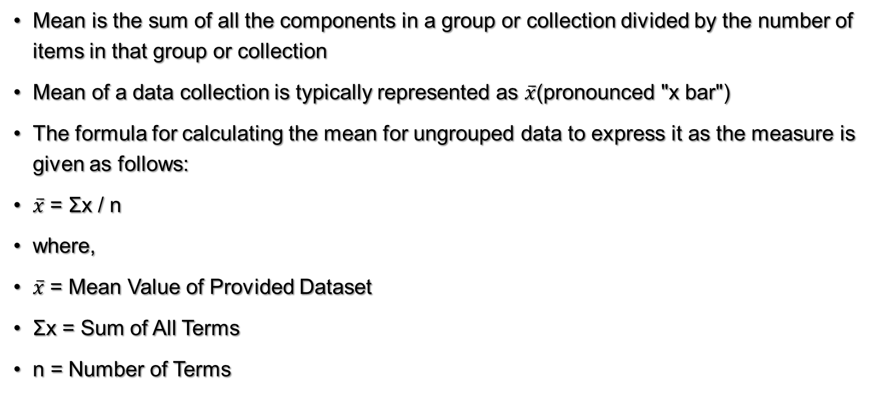
MEAN

Slide 12
Example: Weights of 7 girls in kg are 54, 32, 45, 61, 20, 66 and 50. determine the mean weight for the provided collection of data.
Mean = Σx/n
= (54 + 32 + 45 + 61 + 20 + 66 + 50)/7
= 328 / 7
= 46.85
Thus, the group's mean weight is 46.85 kg.

Slide 13
MEDIAN
Median of a data set is the value of the middle-most observation obtained after organizing the data in ascending order, which is one of the measures of central tendency. Median formula may be used to compute the median for many types of data, such as grouped and ungrouped data.
Ungrouped Data Median (n is odd): [(n + 1)/2]th term
Ungrouped Data Median (n is even): [(n / 2)th term + ((n / 2) + 1)th term]/2
where,
n = Number of Terms

Slide 14
Example: Weights of 7 girls in kg are 54, 32, 45, 61, 20, 66 and 50. Determine the median weight for the provided collection of data.
Arrange the provided data collection in ascending order: 20, 32, 45, 50, 54, 61, 66
Median = [(n + 1) / 2]th term
= [(7 + 1) / 2]th term
= 4th term
= 50
Thus, group's median weight is 50 kg.

Slide 15
MODE
One of the measures of central tendency, defined as the value that appears the most frequently in the provided data, i.e. the observation with the highest frequency is known as the mode of data
Mode of Ungrouped Data: Most Repeated Observation in Dataset

Slide 16
Example: Weights of 7 girls in kg are 54, 32, 45, 61, 20, 45 and 50. Determine the mode weight for the provided collection of data.
Mode = Most repeated observation in Dataset
= 45
Thus, group's mode weight is 45 kg.

Slide 17
MEASURES OF DISPERSION
If the variability of data within an experiment must be established, absolute measures of variability should be employed
Such metrics often reflect differences in a data collection in terms of the average deviations of the observations
Most prevalent absolute measurements of deviation are:
Range
Standard Deviation
Variance

Slide 18
RANGE
Represents the spread of data from the lowest to the highest value in the distribution
It is the most straightforward measure of variability to compute
To get the range, subtract the data set's lowest and highest values.
Range = Highest Value – Lowest Value
Example: Calculate the range of the following data series: 5, 13, 32, 42, 15, 84
Arrange the provided data series in ascending order: 5, 13, 15, 32, 42, 84
Range = H - L
= 84 - 5
= 79
So, the range is 79.

Slide 19
STANDARD DEVIATION – [1]
Standard deviation (s or SD) represents the average level of variability in your dataset
Represents the average deviation of each score from the mean
Higher the standard deviation, the more varied the dataset is.

Slide 20
STANDARD DEVIATION – [2]
To calculate standard deviation, follow these six steps:
Step 1: Make a list of each score and calculate the mean.
Step 2: Calculate deviation from the mean, by subtracting the mean from each score.
Step 3: Square each of these differences.
Step 4: Sum up all squared variances.
Step 5: Divide the total of squared variances by N-1.
Step 6: Find the square root of the number that you discovered.

Slide 21
Example: calculate standard deviation of the following data series: 5, 13, 32, 42, 15, 84.
Solution:
Step 1: First we have to calculate the mean of following series using formula: Σx / n
Step 2: Now calculate the deviation from mean, subtract the mean from each series.
Step 3: Squared the deviation from mean and then add all the deviation.
Series | Deviation from Mean | Squared Deviation
5 | 5-31.83 = -26.83 | 719.85
13 | 13-31.83 = -18.83 | 354.57
32 | 32-31.83 = 0.17 | 0.0289
42 | 42-31.83 = 10.17 | 103.43
15 | 15-31.83 = -16.83 | 283.25
84 | 84-31.83 = 52.17 | 2721.71
Mean = 191/6 = 31.83 | sum = 0 | Sum = 4182.84

Slide 22
STANDARD DEVIATION – [3]
Step 4: Divide the squared deviation with N-1 => 4182.84 / 5 = 836.57
Step 5: √836.57 = 28.92
So, the standard deviation is 28.92

Slide 23
VARIANCE – [1]
Calculated as average of squared departures from the mean
Measures the degree of dispersion in a data collection
The more scattered the data, the larger the variance in relation to the mean
To calculate the variance, square the standard deviation.
Symbol for variance is s²

Slide 24
Example: Calculate the variance of the following data series: 5, 13, 32, 42, 15, 84.
Solution:
First we have to calculate the standard deviation, that we calculate above i.e.
SD = 28.92
s² = (SD)² = (28.92)² = 836.37
So, the variance is 836.37

Slide 25
MEASURES OF FREQUENCY DISTRIBUTION
Datasets consist of various scores or values
Statisticians employ graphs and tables to summarize the occurrence of each possible value of a variable, often presented in percentages or numerical figures
For instance, suppose you were conducting a poll to determine people's favorite Beatles
You would create one column listing all potential options (John, Paul, George, and Ringo) and another column indicating the number of votes each received
Statisticians represent these frequency distributions through graphs or tables
Univariate Descriptive Statistics
Bivariate Descriptive Statistics

Slide 26
UNIVARIATE DESCRIPTIVE STATISTICS
Univariate descriptive statistics focus on one thing at a time
We look at each thing individually and use different ways to understand it better.
Programs like SPSS and Excel can be used
If we only look at the average (mean) of something, like how much people earn, it might not give us the true picture, especially if some people earn a lot more or less than others
Instead, we can also look at other things like the middle value (median) or the one that appears most often (mode)
To understand how spread out the values are, we use things like standard deviation and variance along with the range.

Slide 27
BIVARIATE DESCRIPTIVE STATISTICS
When we have information about more than one thing, we can use bivariate or multivariate descriptive statistics to see if they are related
Bivariate analysis compares two things to see if they change together
Before doing any more complicated tests, it's important to look at how the two things compare in the middle.
Multivariate analysis is similar to bivariate analysis, but it looks at more than two things at once, which helps us understand relationships even better.

Slide 28
DIFFERENCE BETWEEN DESCRIPTIVE AND INFERENTIAL STATISTICS
Descriptive Statistics | Inferential Statistics
Does not need making predictions or generalizations outside the dataset. | This involves making forecasts or generalizations about a wider population.
Gives basic summary of the sample. | Concludes about the population based on the sample.
Examples include mean, median, mode, standard deviation, etc. | Examples include hypothesis testing, confidence intervals, regression analysis, etc.
Focuses on the properties of the current dataset. | Concentrates on drawing conclusions about the population from sample data.
Helpful for comprehending data patterns and linkages. | Useful for making judgements, predictions, and drawing inferences that go beyond the observed facts.

Slide 29
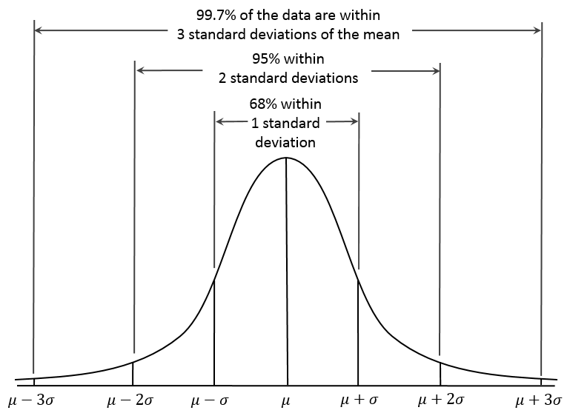
EXPLORATORY DATA ANALYSIS USING DESCRIPTIVE STATISTICS

Slide 30
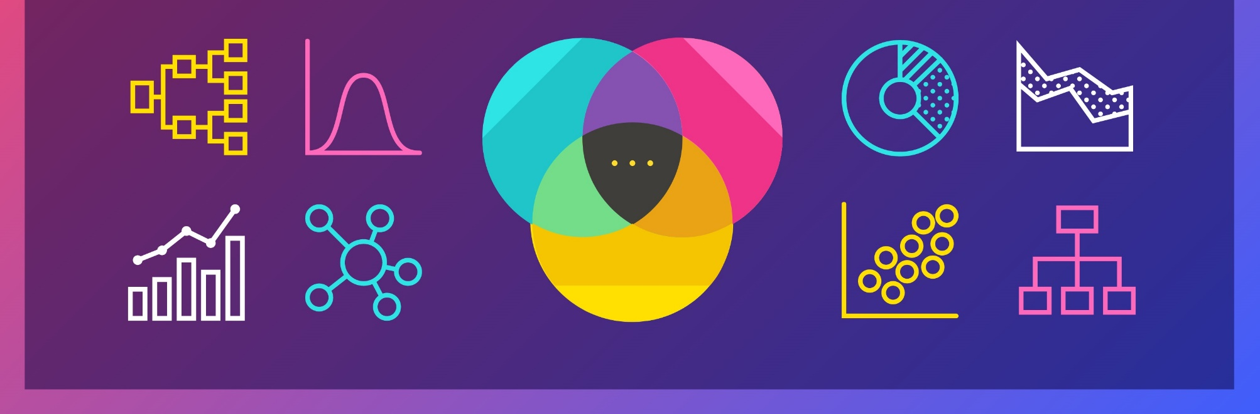
DATA VISUALIZATION
Graphical representation of information and data
Provide an accessible way to see and understand trends, outliers, and patterns in data . by using visual elements like charts, graphs, and maps.

Slide 31
DATA VISUALIZATION TECHNIQUES
Pie Chart
Bar Chart
Histogram
Heat Map
Box and Whisker Plot
Scatter Plot
Waterfall Chart
Area Chart
Choropleth Map
Pictogram Chart
Timeline
Highlight Table
Bullet Graph
Word Cloud
Network Diagram
Correlation Matrices
Gantt Chart

Slide 32
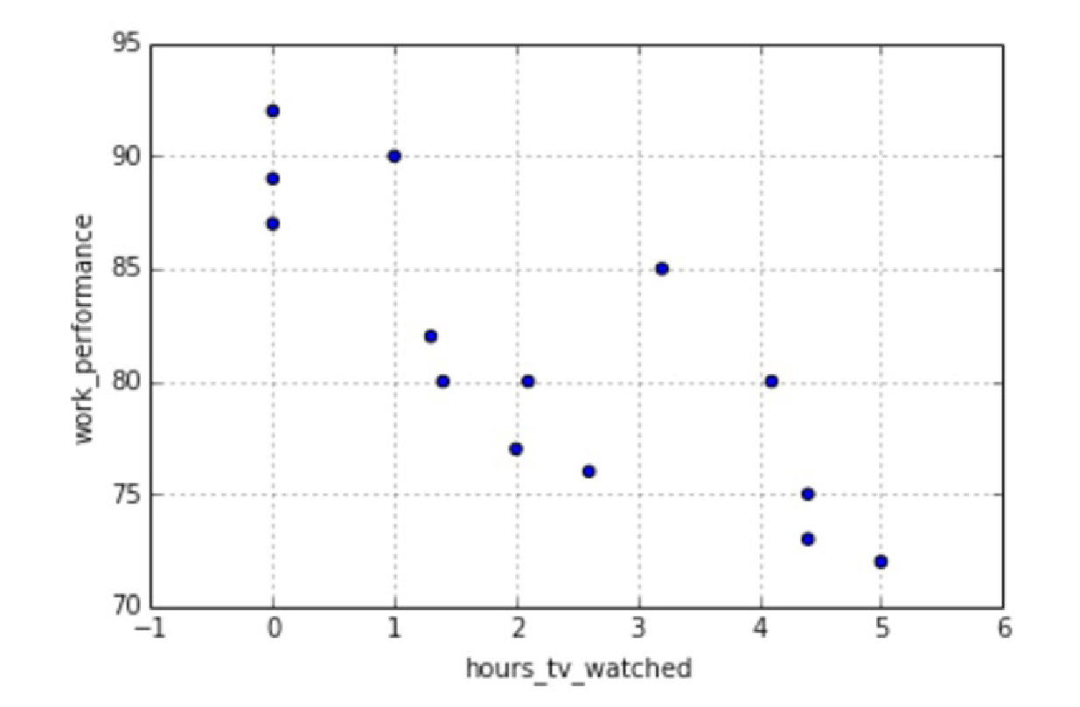
SCATTER PLOT
Displays data for two variables as represented by points plotted against the horizontal and vertical axis
Useful in illustrating the relationships that exist between variables and can be used to identify trends or correlations in data.
Most effective for fairly large data sets, since it’s often easier to identify trends when there are more data points present.
Additionally, the closer the data points are grouped together, the stronger the correlation or trend tends to be.

Slide 33
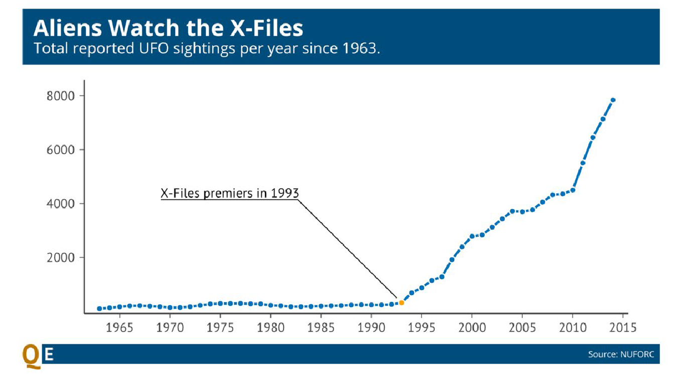
LINE CHARTS
Simply uses lines to connect data points and usually represents time on the x axis.
Popular way to show changes in variables over time
Used to analyze developments over individual values.
Utilized in comparing trends among more than one facts series.
High-quality used for time series information.

Slide 34
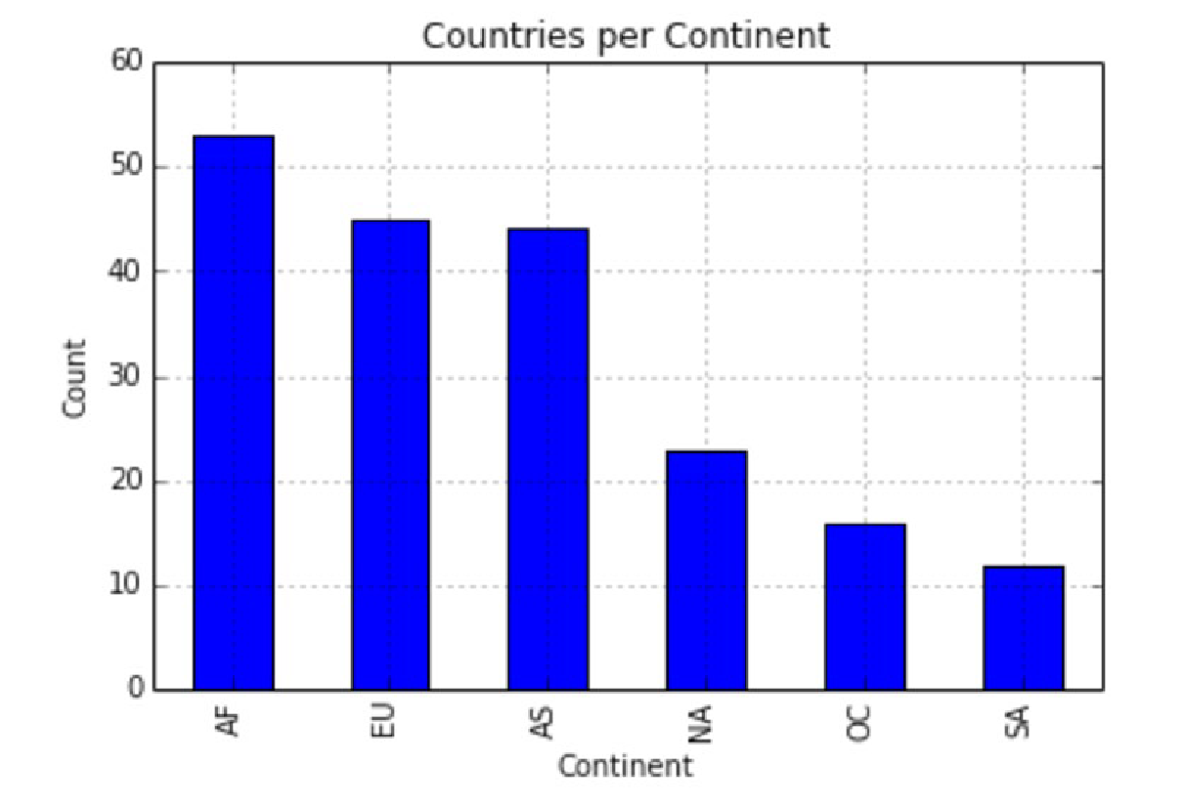
BAR CHART
One axis of the chart shows the categories being compared, and the other, a measured value.
The length of the bar indicates how each group measures according to the value.

Slide 35
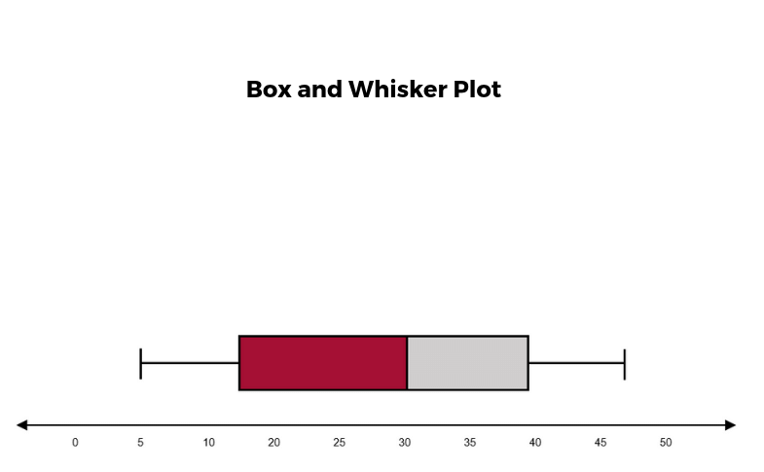
BOX AND WHISKER PLOTS
Created by plotting the minimum value, first quartile (the number that separates the 25% lowest values from the rest), median, third quartile (the number that separates the 25% highest values from the rest), maximum value
A line within the box represents the median. “Whiskers,” or lines, are then drawn extending from the box to the minimum (lower extreme) and maximum (upper extreme).
Outliers are represented by individual points that are in-line with the whiskers.
Helpful in quickly identifying whether or not the data is symmetrical or skewed, as well as providing a visual summary of the data set that can be easily interpreted

Slide 36
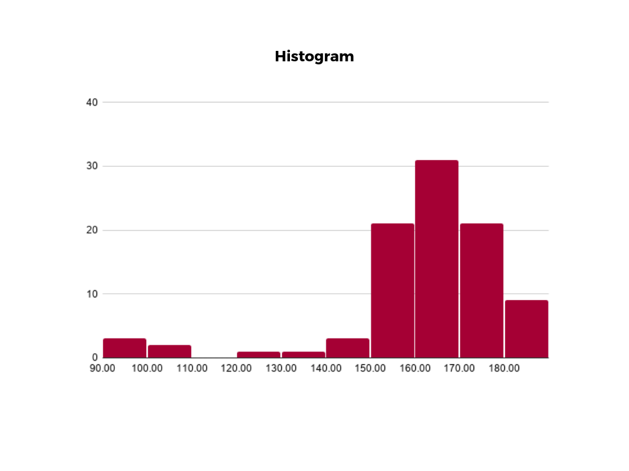
HISTOGRAMS
Illustrate the distribution of data over a continuous interval or defined period
Helpful in identifying where values are concentrated, as well as where there are gaps or unusual values
Useful for showing the frequency of a particular occurrence
For instance, if to show how many clicks received by website each day over the last week, a histogram can be used

Slide 37
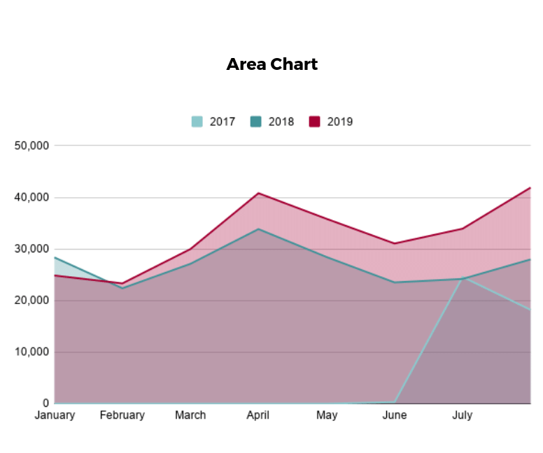
AREA CHART
A variation on a basic line graph in which the area underneath the line is shaded to represent the total value of each data point
When several data series must be compared on the same graph, stacked area charts are used.
Useful for showing changes in one or more quantities over time, as well as showing how each quantity combines to make up the whole
Stacked area charts are effective in showing part-to-whole comparisons.

Slide 38
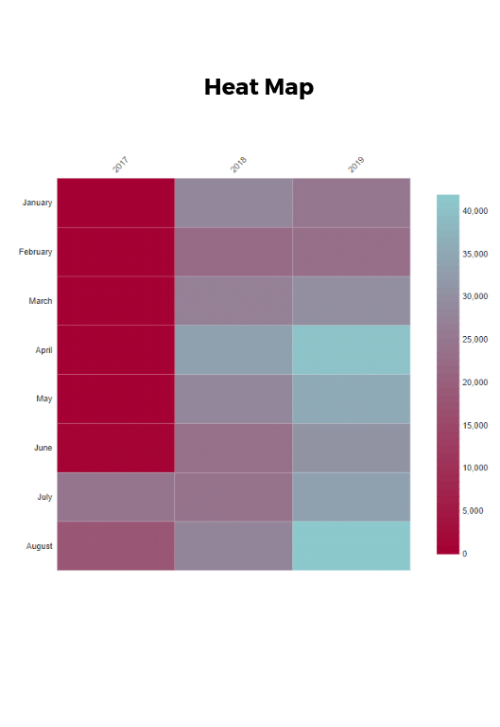
HEAT MAP
Used to show differences in data through variations in color
Use color to communicate values in a way that makes it easy for the viewer to quickly identify trends
Having a clear legend is necessary in order for a user to successfully read and interpret a heatmap.
Shading in the matrix with colors that correspond to the number of sales at each time of day, trends in the data can be identified that allow to determine the exact times your store experiences the most sales

Slide 39
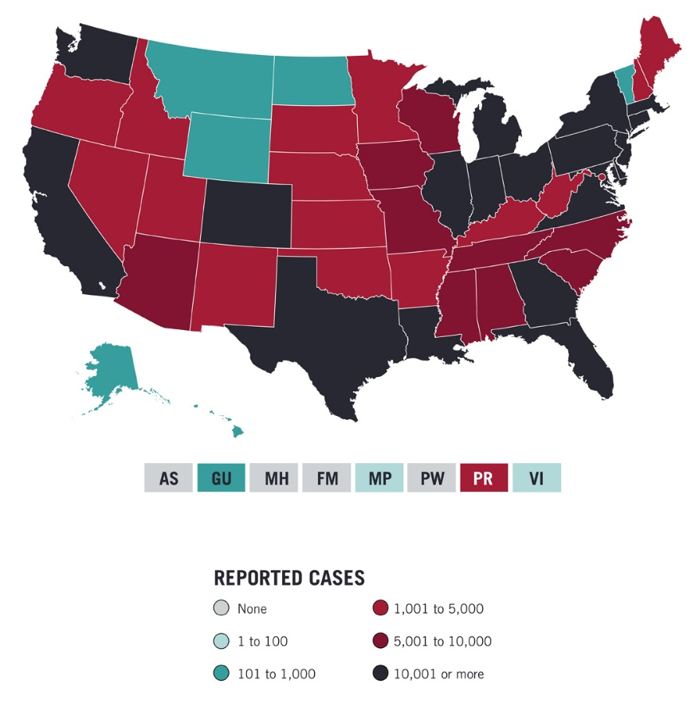
CHOROPLETH MAPS
Uses color, shading, and other patterns to visualize numerical values across geographic regions
Use a progression of color (or shading) on a spectrum to distinguish high values from low.
Allow viewers to see how a variable changes from one region to the next
Exact numerical values aren’t easily accessible because the colors represent a range of values. Some data visualization tools, however, allow to add interactivity to your map so the exact values are accessible.

Slide 40
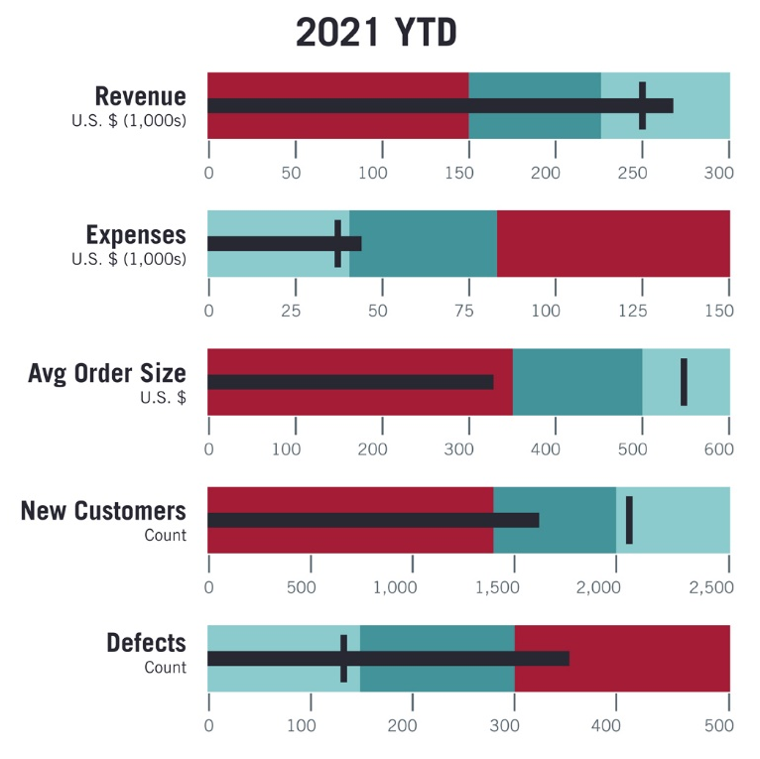
BULLET GRAPH
Use to inform the viewer of how a business is performing in comparison to benchmarks that are in place for key business metrics.
Darker horizontal bar in the middle of the chart represents the actual value, while the vertical line represents a comparative value, or target
If the horizontal bar passes the vertical line, the target for that metric has been surpassed
Segmented colored sections behind the horizontal bar represent range scores, such as “poor,” “fair,” or “good.”

Slide 41
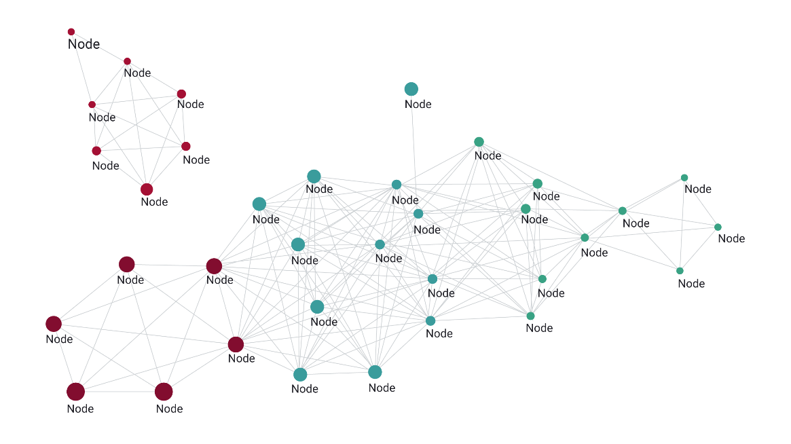
NETWORK DIAGRAMS
Relationships between qualitative data points
Composed of nodes and links, also called edges
Nodes are singular data points that are connected to other nodes through edges, which show the relationship between multiple nodes.
Used to depict social networks, highlight the relationships between employees at an organization, or visualizing product sales across geographic regions

Slide 42
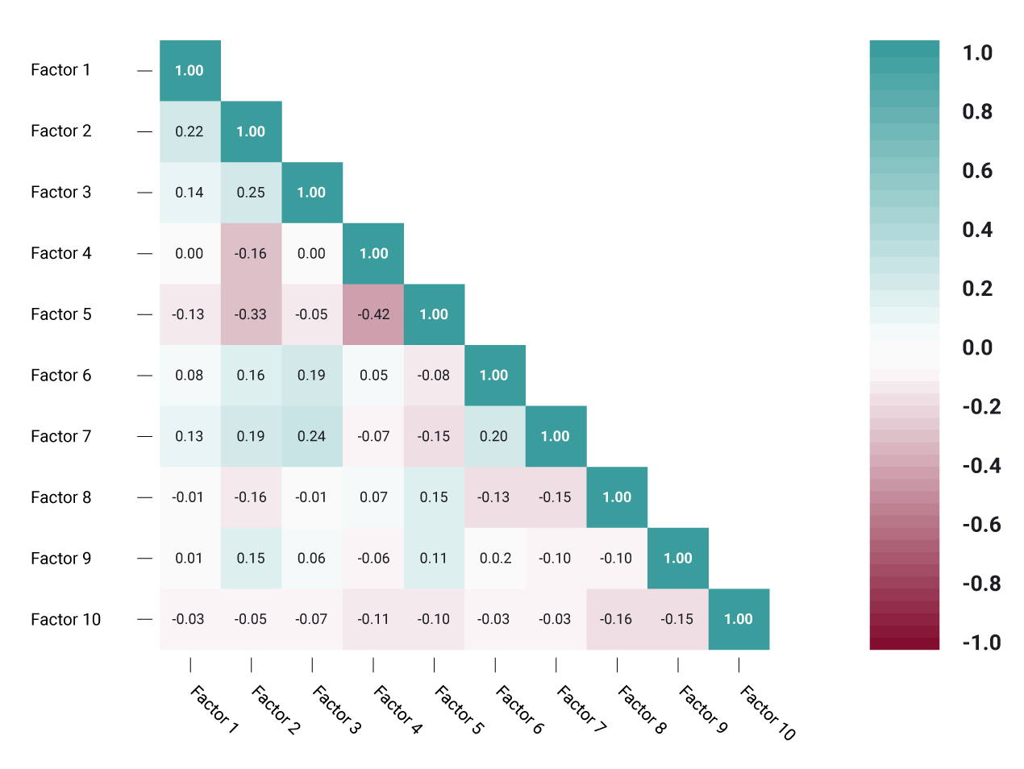
CORRELATION MATRICES
Table that shows correlation coefficients between variables
Each cell represents the relationship between two variables, and a color scale is used to communicate whether the variables are correlated and to what extent.
Useful to summarize and find patterns in large data sets
In business, it might be used to analyze how different data points about a specific product might be related, such as price, advertising spend, launch date

Slide 43
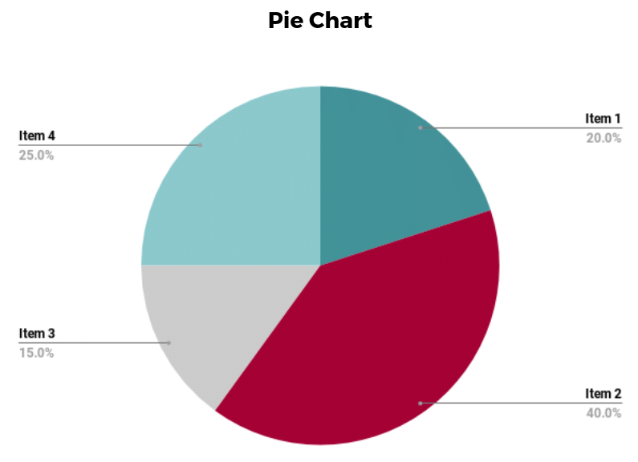
PIE CHARTS
Ideal for illustrating proportions, or part-to-whole comparisons
Best suited for audiences who might be unfamiliar with the information or are only interested in the key takeaways
For viewers who require a more thorough explanation of the data, pie charts fall short in their ability to display complex information

Slide 44
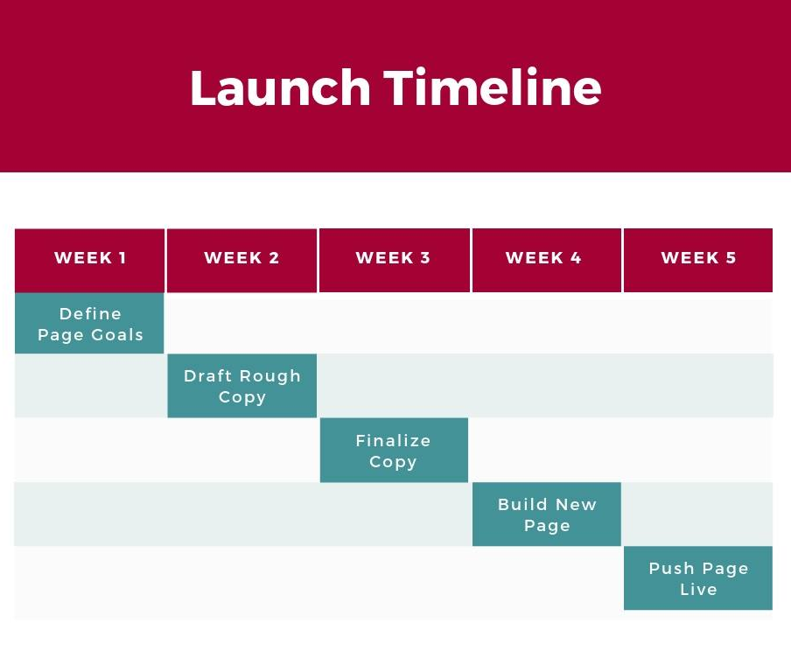
GANTT CHART
Particularly common in project management, as useful in illustrating a project timeline or progression of tasks
Tasks to be performed are listed on the vertical axis and time intervals on the horizontal axis.
Horizontal bars in the body of the chart represent the duration of each activity.
Display timelines can be incredibly helpful, and enable team members to keep track of every aspect of a project

Slide 45
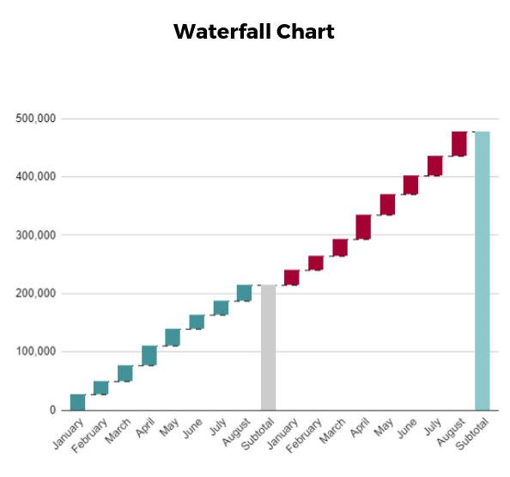
WATERFALL CHART
A visual representation that illustrates how a value changes as it’s influenced by different factors, such as time
Goal to show the viewer how a value has grown or declined over a defined period
For example, waterfall charts are popular for showing spending or earnings over time

Slide 46
PRINCIPLES OF EFFECTIVE DATA VISUALIZATION
Diagram First
Use the Right Software
Use an Effective Geometry and Show Data
Colors Always Mean Something
Include Uncertainty
Panel, when Possible (Small Multiples)
Data and Models Are Different Things
Simple Visuals, Detailed Captions
Consider an Infographic
Get an Opinion

Slide 47
DIAGRAM FIRST
Before preparing a visual, the information to be shared should be prioritized, envisioned and designed
Focus on the information and message first, before engaging with software that in some way starts to limit or bias visual tools. i.e., don't necessarily think of the geometries (dots, lines) you will eventually use, but think about the core information that needs to be conveyed and what about that information is going to make your point(s). Is your visual objective to show a comparison? A ranking? A composition?
This step can be done mentally, or with a pen and paper for maximum freedom of thought
It can be a good idea to save figures you come across in scientific literature that you identify as particularly effective

Slide 48
USE THE RIGHT SOFTWARE
Effective visuals typically require good command of one or more software
It might be unrealistic to expect complex, technical, and effective figures if we are using a simple spreadsheet program or some other software that is not designed to make complex, technical, and effective figures
Recognize that we might need to learn a new software—or expand our knowledge of a software we already know
While highly effective and aesthetically pleasing figures can be made quickly and simply, this may still represent a challenge to some.
Figure making is a method like anything else, and in order to do it, new methodologies may need to be learned.

Slide 49
USE AN EFFECTIVE GEOMETRY AND SHOW DATA
Geometries are the shapes and features that are often synonymous with a type of figure e.g. the bar geometry creates a bar plot
While geometries might be the defining visual element of a figure, it can be directed directly from a dataset to pairing it with one of a small number of well-known geometries
Most geometries fall into categories: amounts (or comparisons), compositions (or proportions), distributions, or relationships.
Geometries for amounts should only be used when the data do not have distributional information or uncertainty associated with them
Good use of a bar plot might be to show counts of something, while poor use of a bar plot might be to show group means

Slide 50
COLORS ALWAYS MEAN SOMETHING
Many (non-mapping) visualizations use color in one of three schemes: sequential, diverging, or qualitative
Sequential color schemes range from light to dark typically in one or two (related) hues and are often applied to convey increasing values for increasing darkness
Diverging color schemes have two sequential schemes that represent two extremes, often with a white or neutral color in the middle
Whenever possible, use color that can be converted to an effective grayscale such that no information is lost in the conversion
Colors can be combined with symbols, line types, and other design elements to share the same information that the color was sharing
Color will often be the first visual information a reader gets, and with this knowledge color should be strategically used to amplify visual message

Slide 51
INCLUDE UNCERTAINTY – [1]
Failure to include uncertainty in a visual can be misleading
Two primary challenges exist with including uncertainty in visuals: failure to include uncertainty and misrepresentation (or misinterpretation) of uncertainty
Uncertainty is often not included in figures and, therefore, part of the statistical message is left out, possibly calling into question
Including uncertainty is typically easy in most software programs, and can take the form of common geometries such as error bars and shaded intervals (polygons), among other features
Representing uncertainty is often a challenge
Standard deviation, standard error, confidence intervals, and credible intervals are all common metrics of uncertainty, but each represents a different measure.

Slide 52
INCLUDE UNCERTAINTY – [2]
Expressing uncertainty requires that readers be familiar with metrics of uncertainty and their interpretation
However, it is also the responsibility of the figure author to adopt the most appropriate measure of uncertainty
For instance, standard deviation is based on the spread of the data and therefore shares information about the entire population, including the range in which we might expect new values
On the other hand, standard error is a measure of the uncertainty in the mean (or some other estimate) and is strongly influenced by sample size

Slide 53
PANEL, WHEN POSSIBLE (SMALL MULTIPLES)
A particularly effective visual approach is to repeat a figure to highlight differences. This approach is often called small multiples, and the technique may be known as paneling or faceting
The strategy behind small multiples is that because many of the design elements are the same
For example, the axes, axes scales, and geometry are often the same i.e. the differences in the data are easier to show
Each panel represents a change in one variable, which is commonly a time step, a group, or some other factor
Objective of small multiples is to make the data inevitably comparable, and effective small multiples always accomplish these comparisons.

Slide 54
DATA AND MODELS ARE DIFFERENT THINGS
Plotted information typically takes the form of raw data (e.g. scatterplot), summarized data (e.g. box plot), or an inferential statistic (e.g. fitted regression line)
Raw data and summarized data are often relatively straightforward
However, a plotted model may require more explanation for a reader to be able to fully reproduce the work
Certainly any model in a study should be reported in a complete way that ensures reproducibility
However, any visual of a model should be explained in the figure caption or referenced else where in the document so that a reader can find the complete details on what the model visual is representing

Slide 55
SIMPLE VISUALS, DETAILED CAPTIONS
As important as it is to use high data-ink ratios, it is equally important to have detailed captions that fully explain everything in the figure
Captions should be standalone, which means that if the figure and caption were looked at independent from the rest of the study, the major point(s) could still be understood
Obviously not all figures can be completely standalone, as some statistical models and other procedures require more than a caption as explanation
However, the principle remains that captions should do all they can to explain the visualization and representations used
Captions should explain any geometries used, for instance, even in a simple scatterplot it should be stated that the black dots represent the data

Slide 56
CONSIDER AN INFOGRAPHIC
Figures tend to be focused on representing data and models, whereas infographics typically incorporate text, images, and other diagrammatic elements
Although it is not recommended to convert all figures to infographics, infographics were found to have the highest memorability score and that diagrams outperformed points, bars, lines, and tables in terms of memorability
Scientists might improve their overall information transfer if they consider an infographic where blending different pieces of information could be effective
An infographic of a study might be more effective outside of a peer-reviewed publication and in an oral or poster presentation where a visual needs to include more elements of the study but with less technical information.
Even if infographics are not adopted in most cases, technical visuals often still benefit from some text or other annotations

Slide 57
GET AN OPINION
Although there may be principles and theories about effective data visualization, the reality is that the most effective visuals are the ones with which readers connect
Figure authors are encouraged to seek external reviews of their figures
Often when writing a study, the figures are quickly made, and even if thoughtfully made they are not subject to objective, outside review
Having one or more colleagues or people external to the study review figures will often provide useful feedback on what readers perceive, and therefore what is effective or ineffective in a visual
When outside colleagues take review the figures (because figure reviews require substantially less time than full document reviews), they are helpful to provide feedback on the figures as they will not have the document text to fill in any uncertainties left by the visuals.

Slide 58
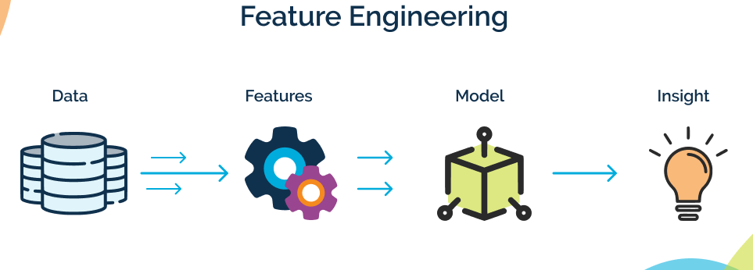
FEATURE ENGINEERING

Slide 59
Feature engineering is the process of representing a problem domain to make it amenable for learning techniques.
This process involves the initial discovery of features and their stepwise improvement based on domain knowledge and the observed performance of a given ML algorithm over specific training data.

Slide 62
OTHER ASPECTS OF DATA MANIPULATION

Slide 63
END OF CHAPTER

